Slide 1


BITS Library Management System
Group- 45

Slide 2


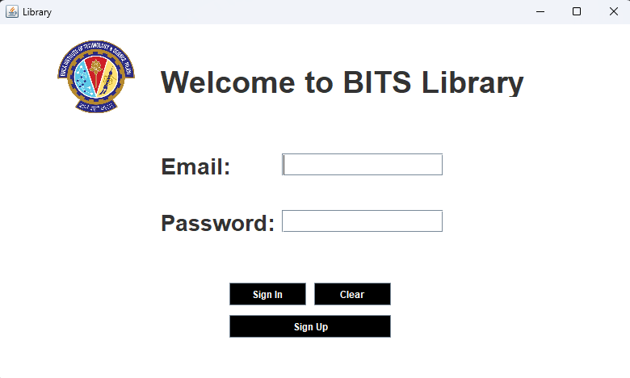
Login page:
Email
Password
Sign In
Clear
Sign Up

Slide 3
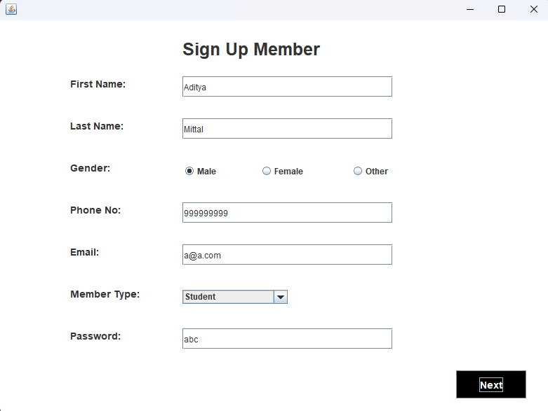
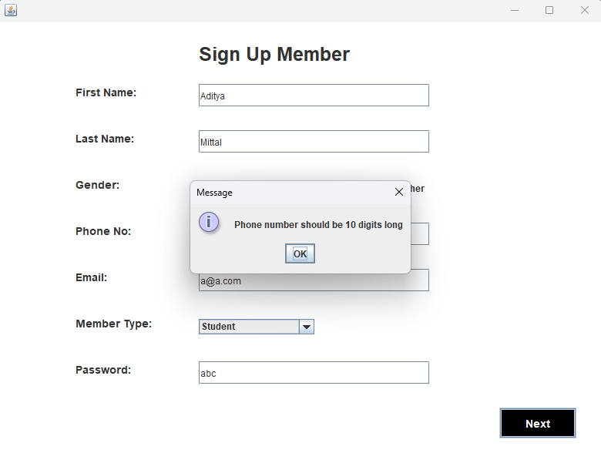
Sign Up Page:
Allows new user (student or teacher) to create a new account in the library.
User can only proceed once he fills up all the fields.

Slide 4
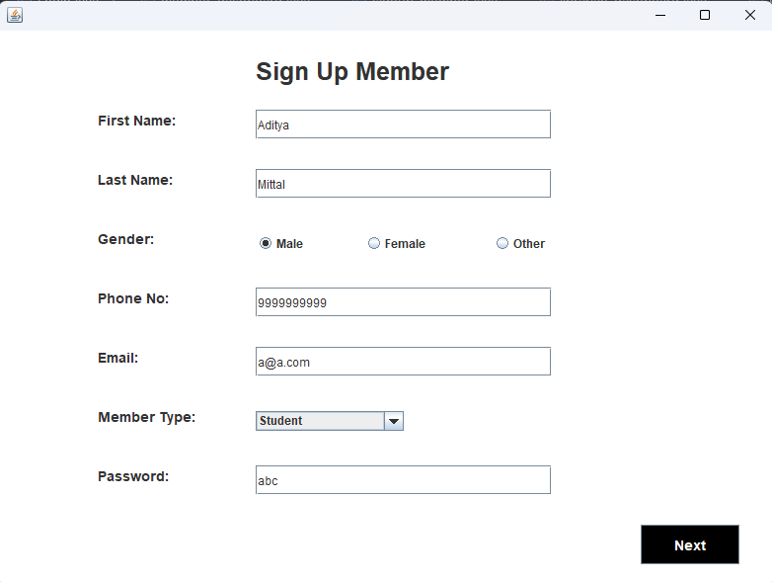
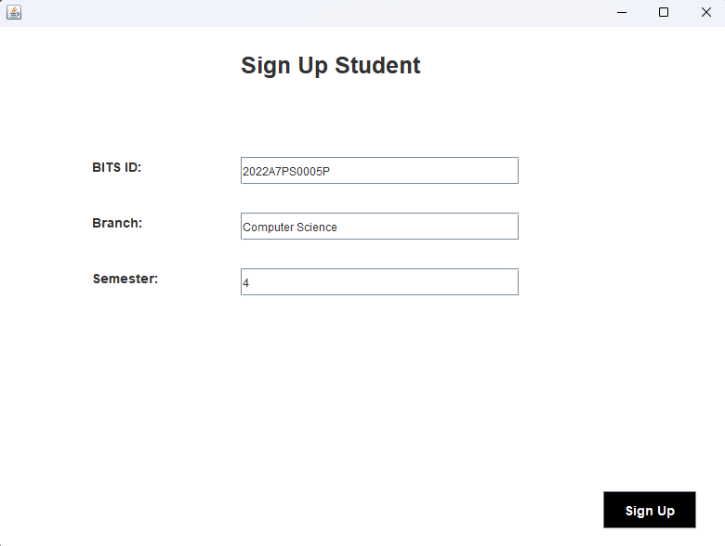
Redirects user to new page based on the member option selected (student or teacher)

Slide 5
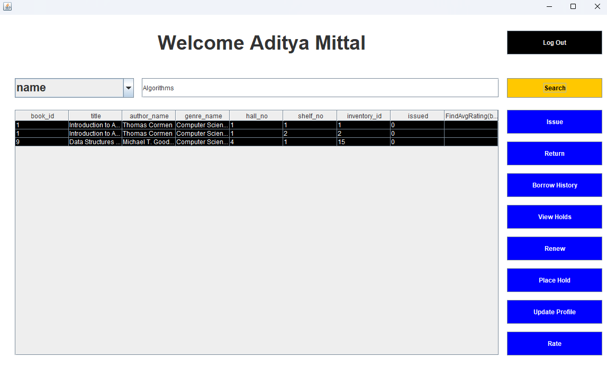
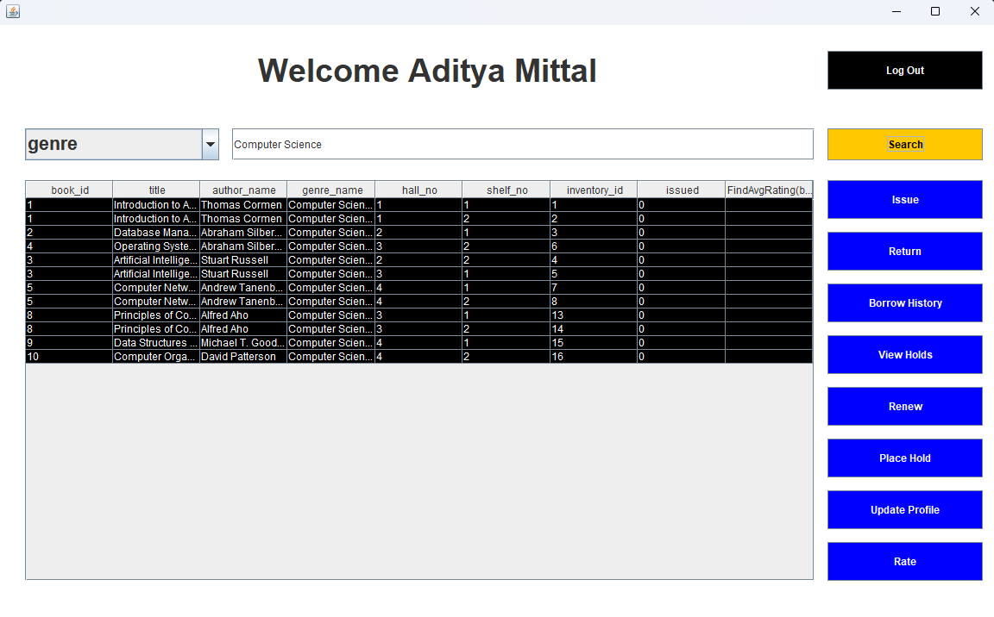
Member dashboard:
Gives options like:
  Issue- to issue a new book
  Return- return borrowed book
  Borrow History- shows borrow history
  Place Hold- Allows user to place hold on a book which is currently not available
  View Holds- Shows holds placed by users
  Renew- Allows user to renew a borrowed book
  Rate- Allows user to rate the borrowed book
  Update Profile- Lets user update details like name, gender and password

Slide 6
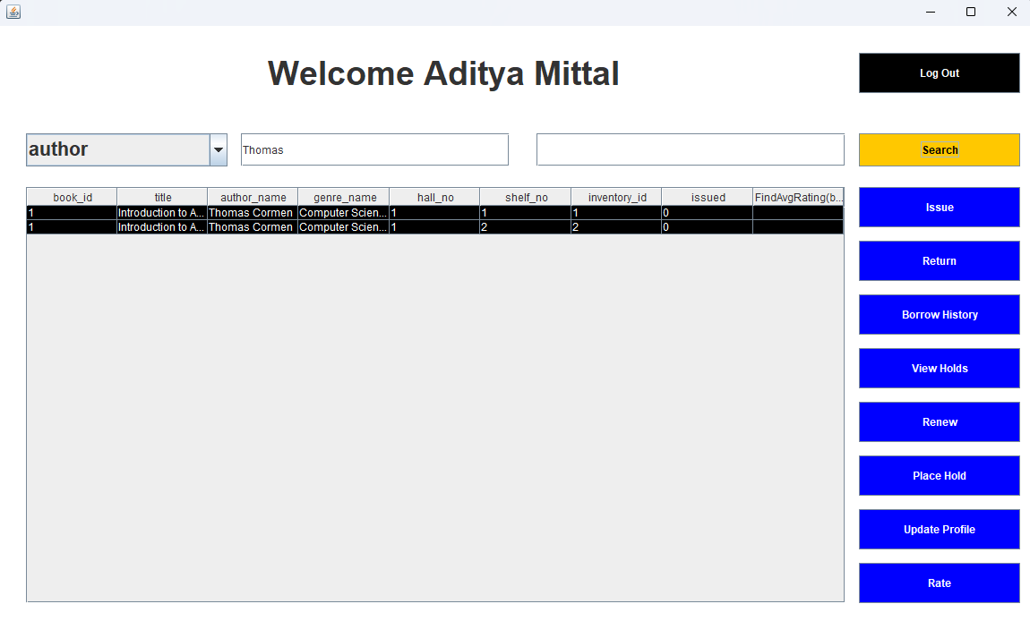
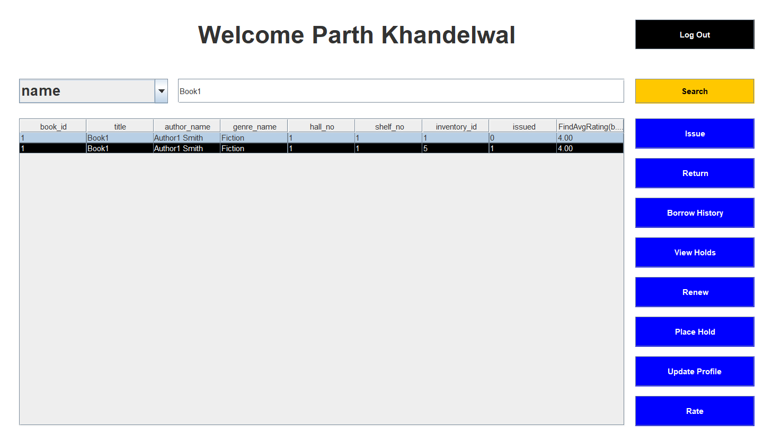
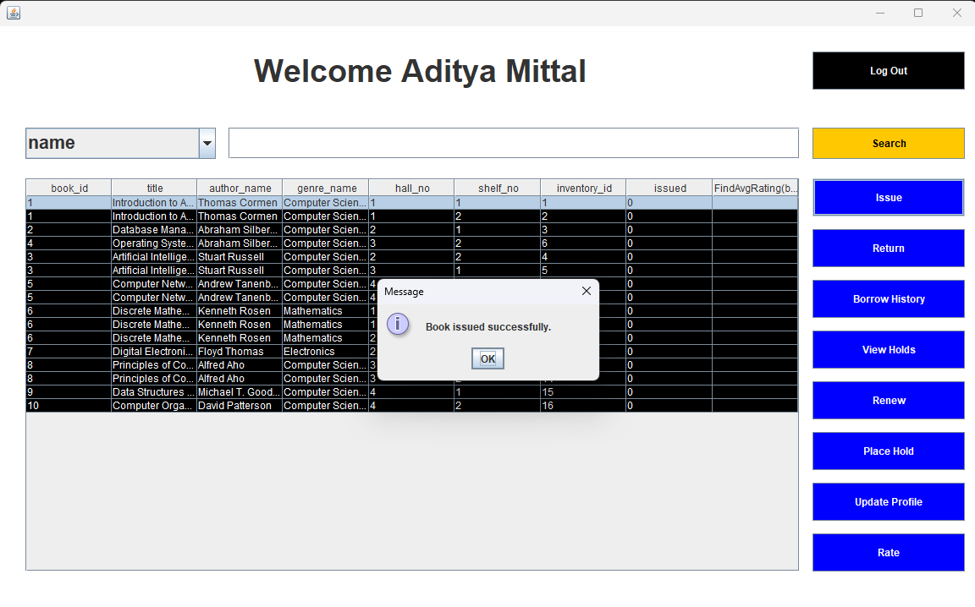
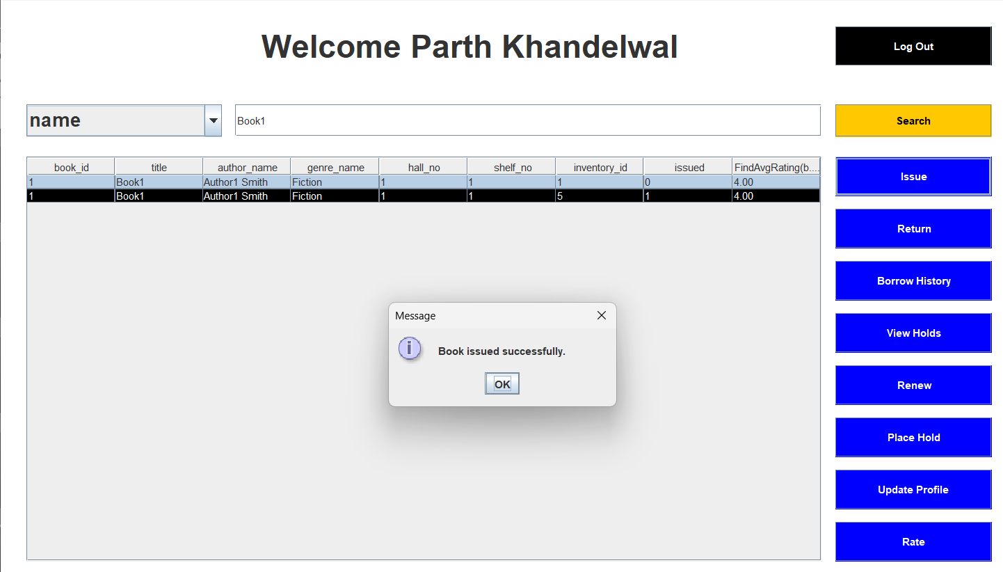
Book Issue Function:
User can search for a book on the basis of name of the book, genre, or author.
Book to be issued can be selected from the result table.

Slide 7
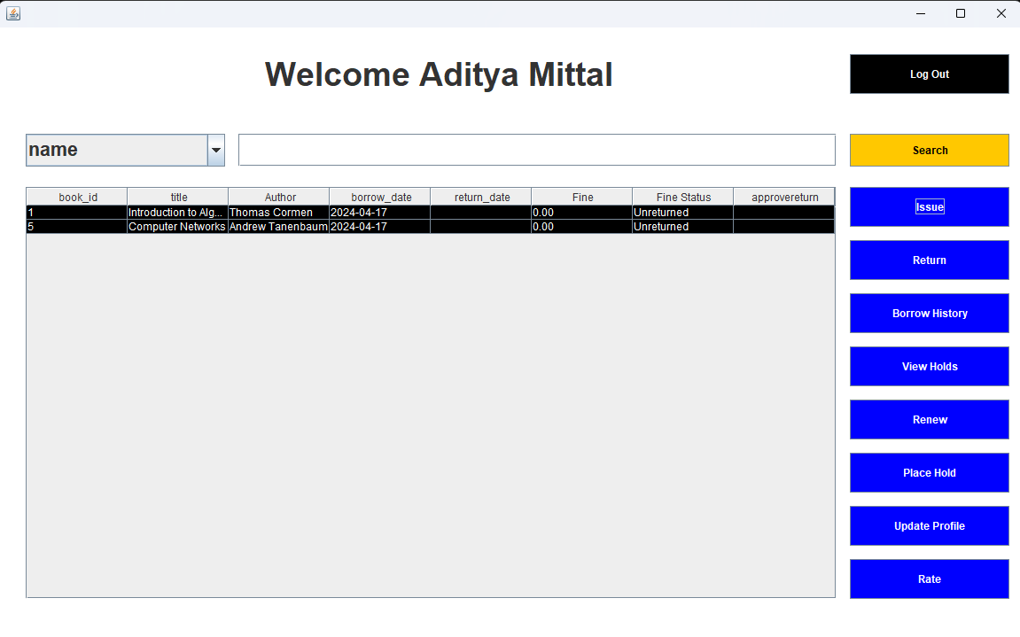
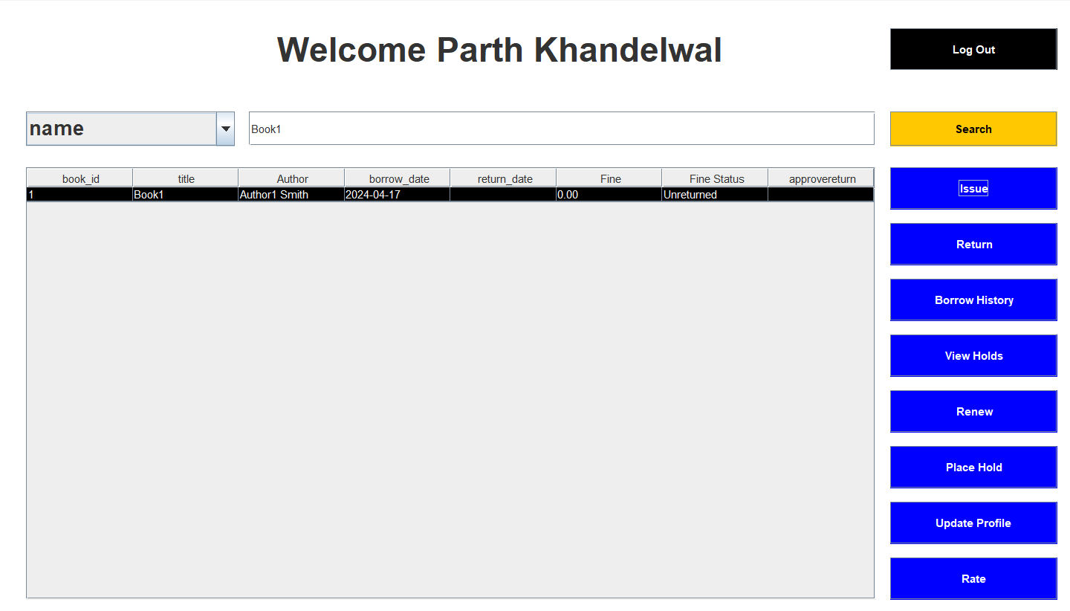
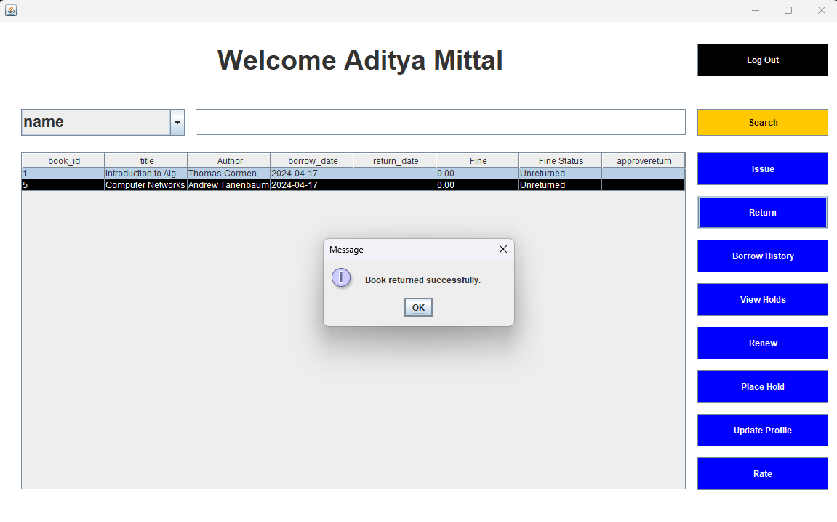
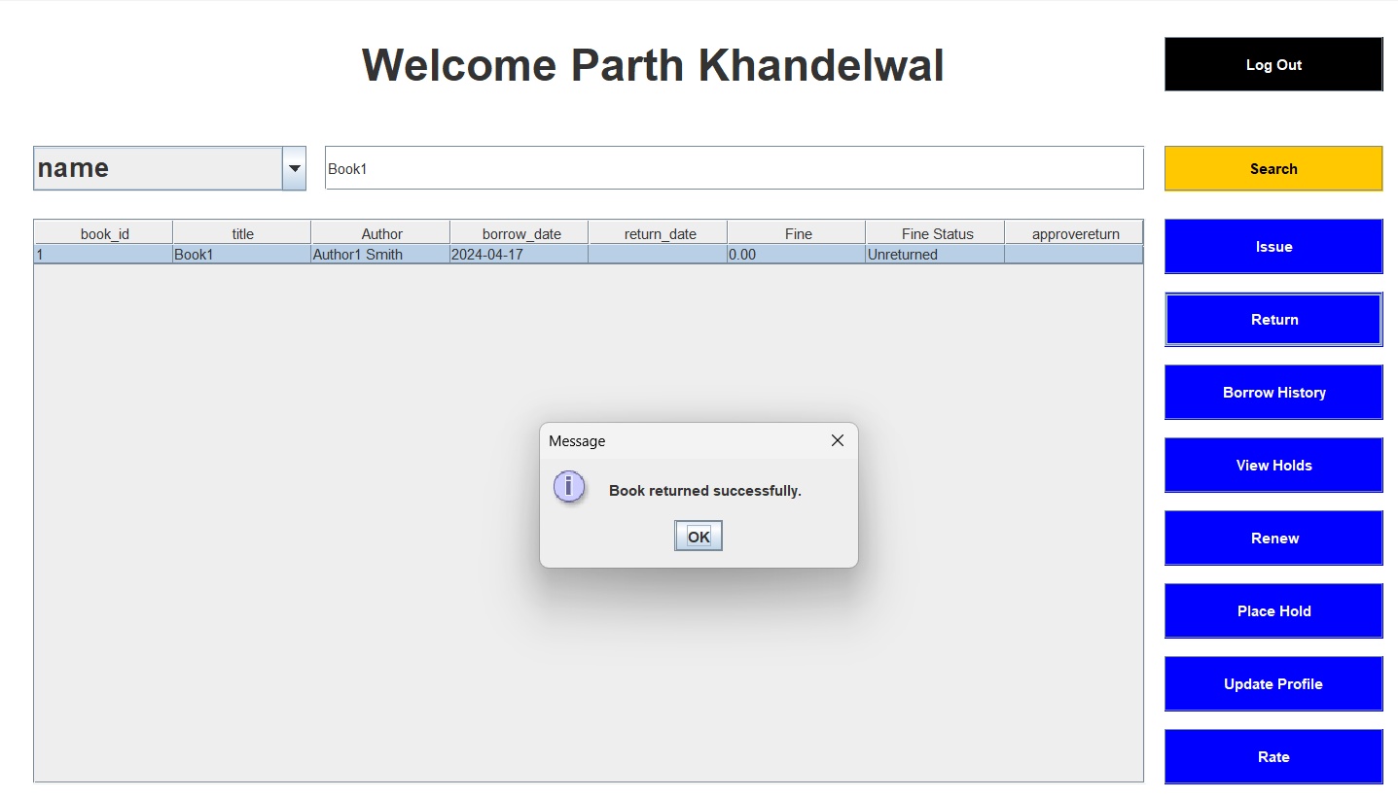
Return Function
User can select the book to be returned from his borrow history.
This just sends a request to the librarian who can approve for the return request from his dashboard.

Slide 8
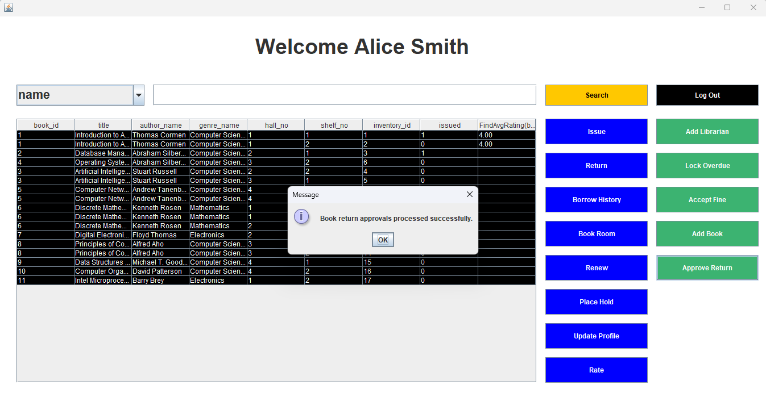
Librarian Dashboard
Return request is approved by librarian through Accept Fine

Slide 9
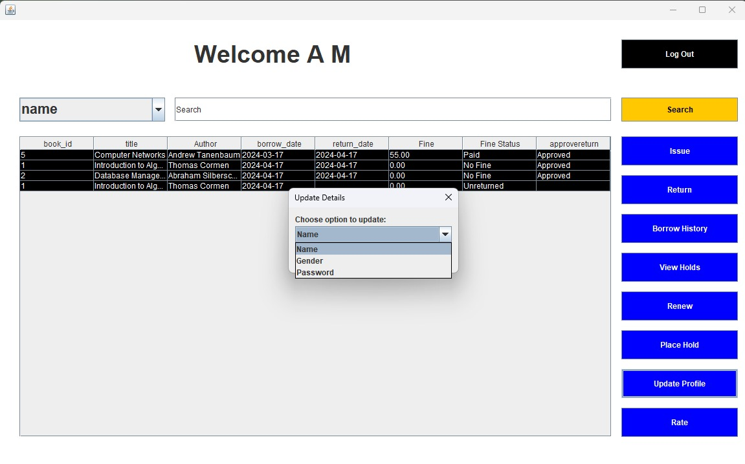
Updating options:
User can update:
  Name
  Gender
  Password

Slide 10
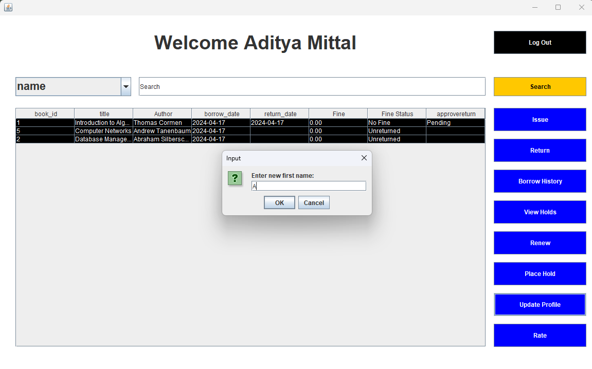
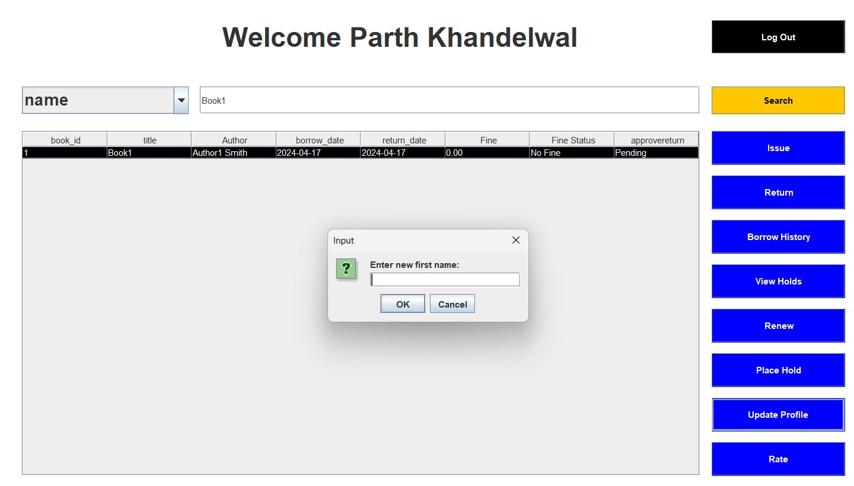
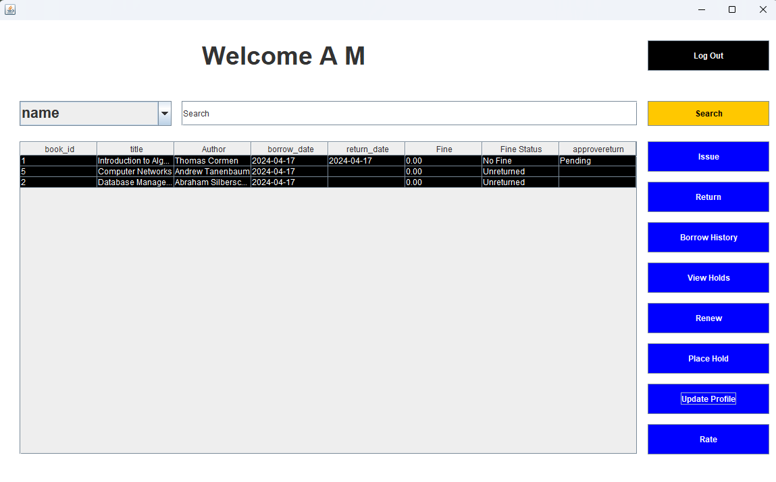
Name change feature
Takes in the first name and last name of the user and updates it in the database.

Slide 11
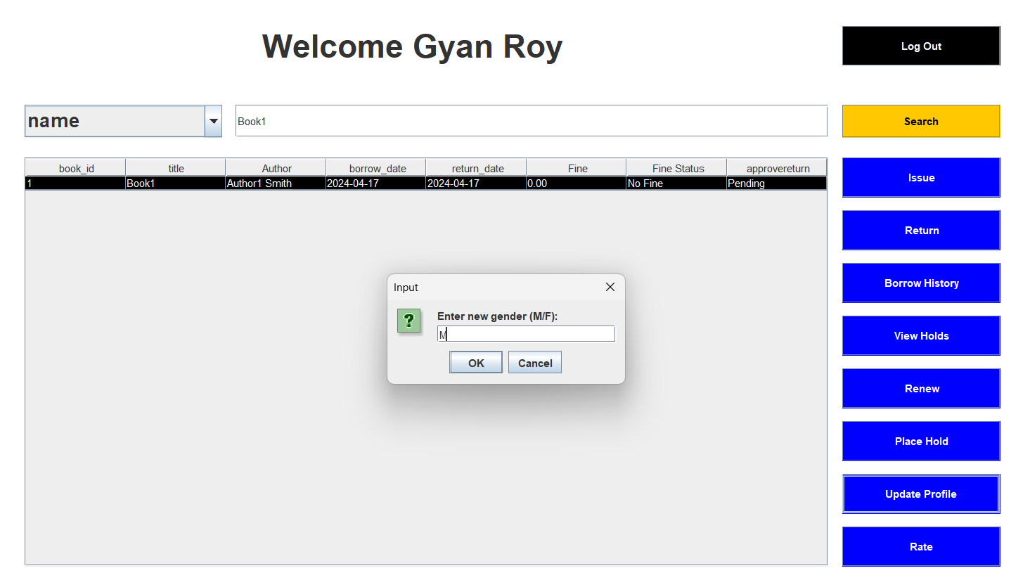
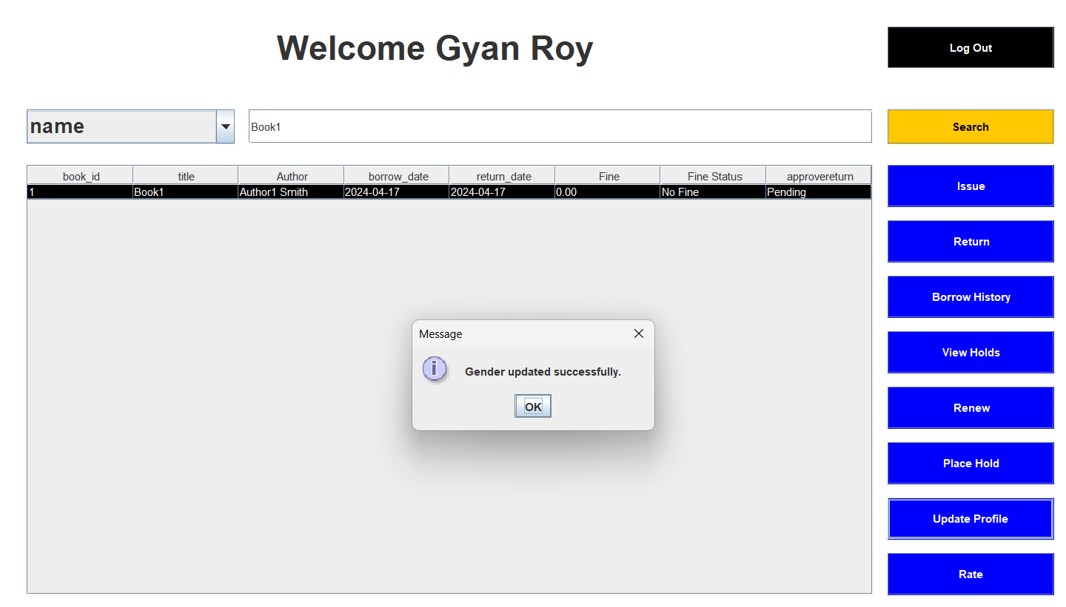
Gender update:
The dialog box allows the user to chose gender.

Slide 12
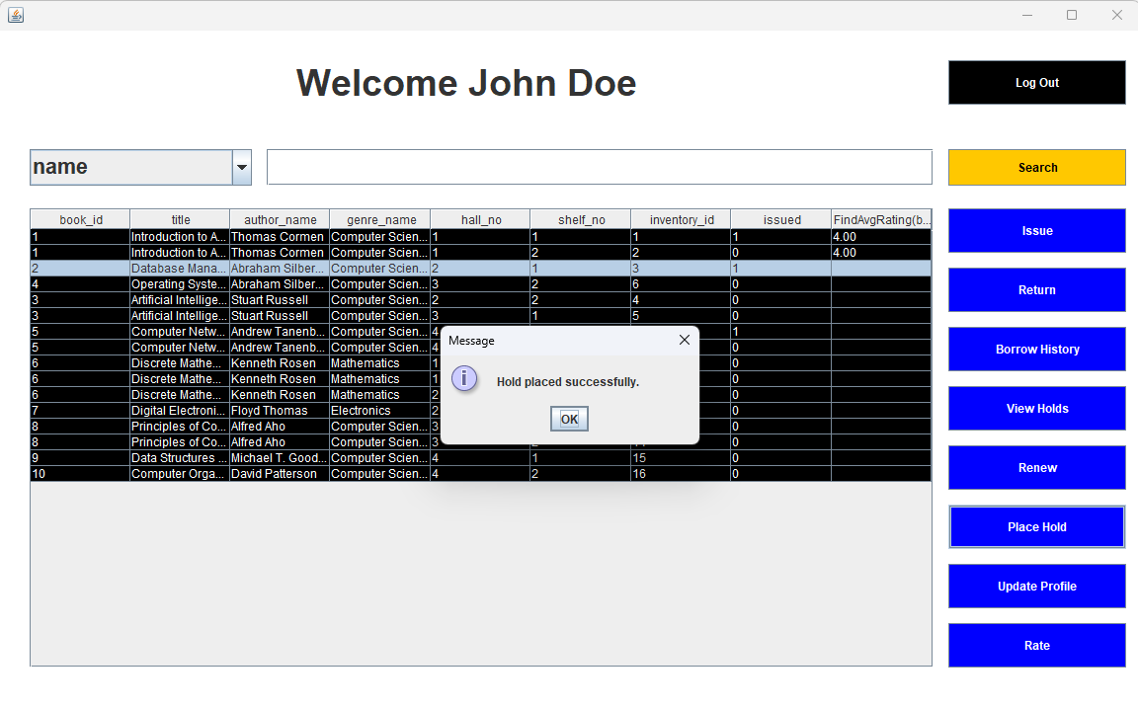
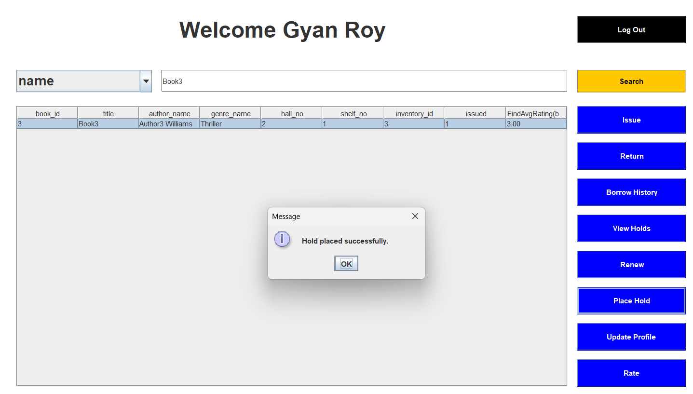
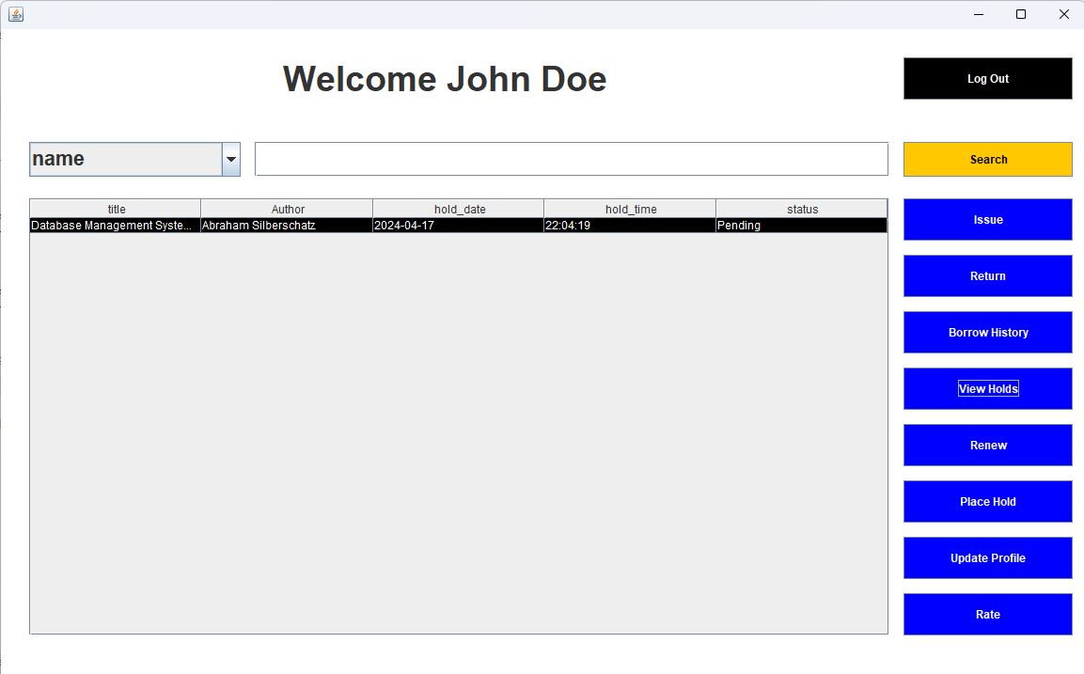
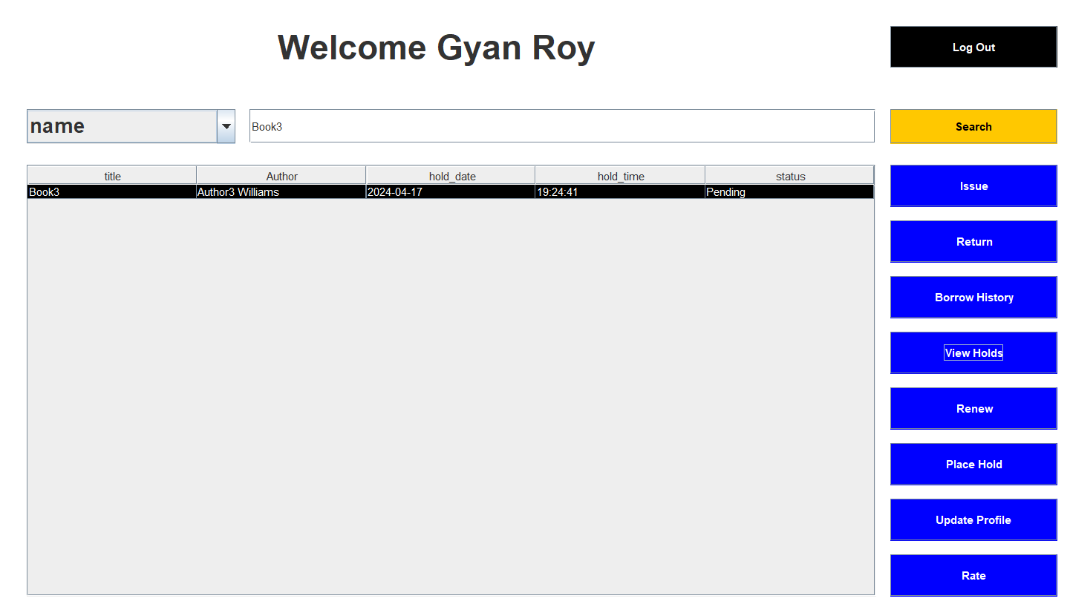
Placing Holds and View Holds
Allows user to place holds on books which are currently unavailable for issuing.
The Status can be viewed using view holds option and is updated once the same book is returned by someone.

Slide 13
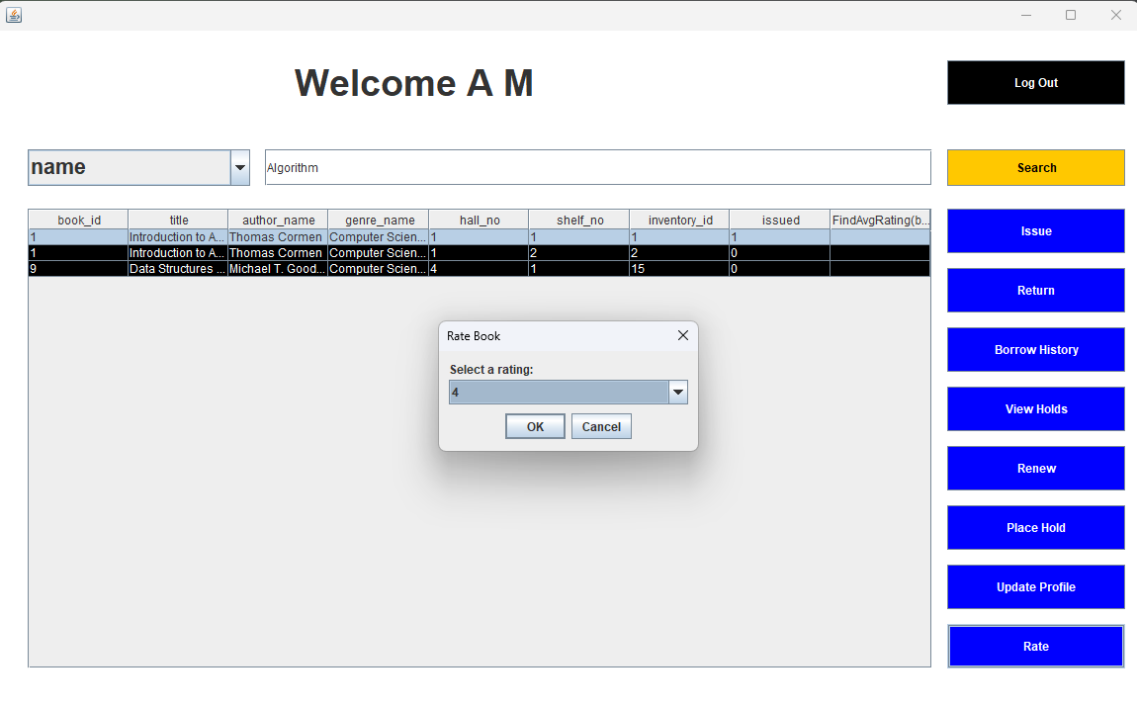
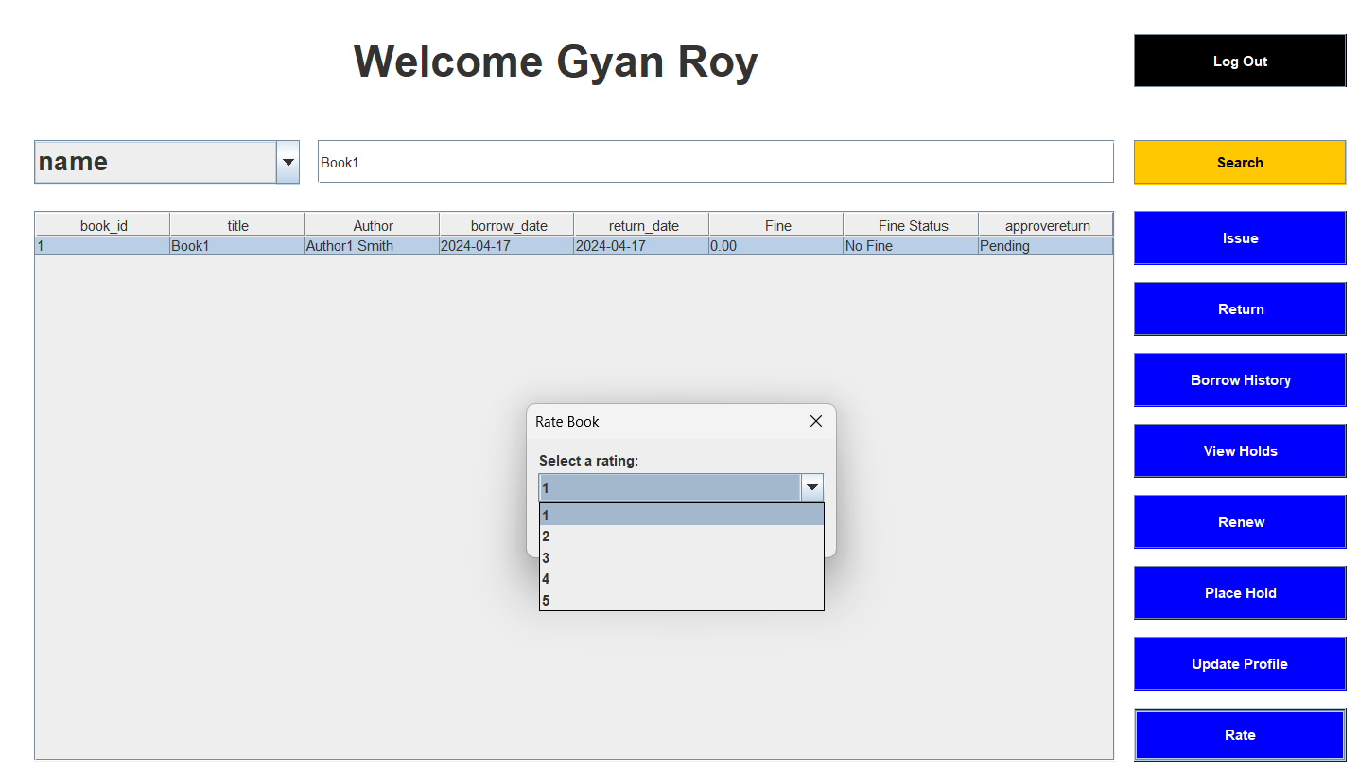
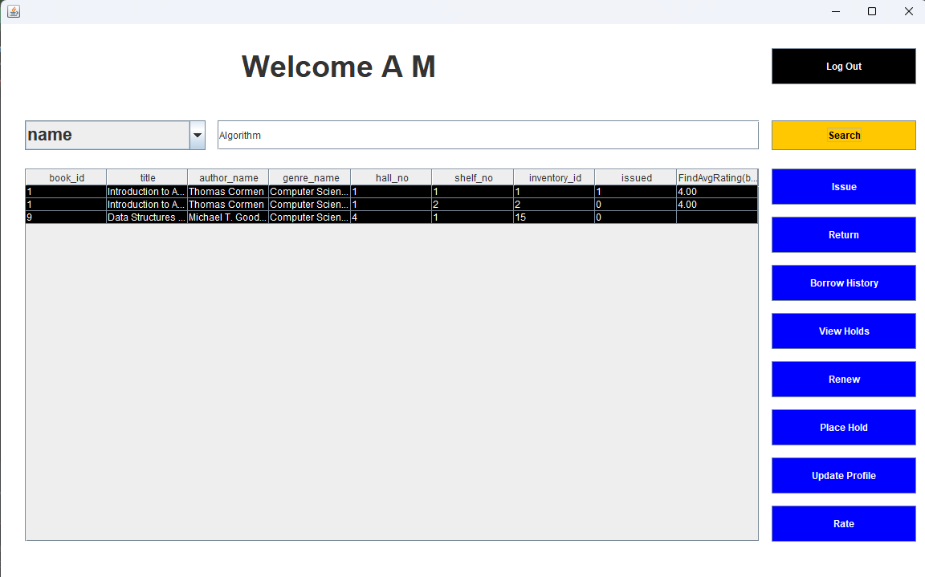
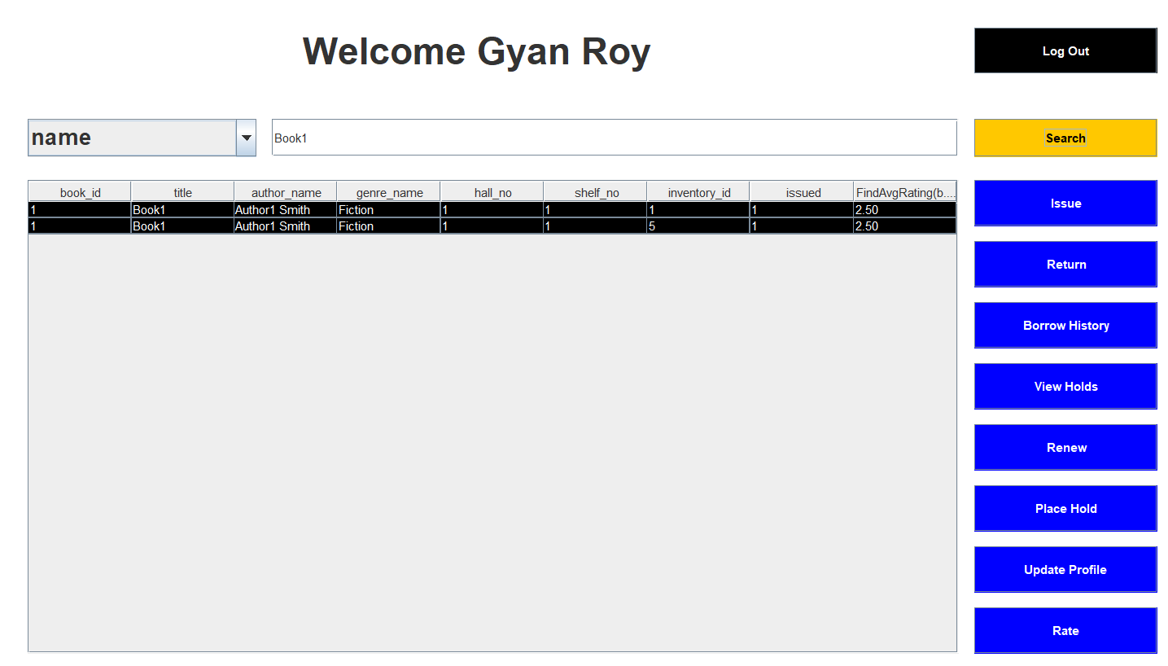
Rate a Book
User can rate any book which he has borrowed so far.
The average rating is displayed alongside the book name when searched for it.

Slide 14
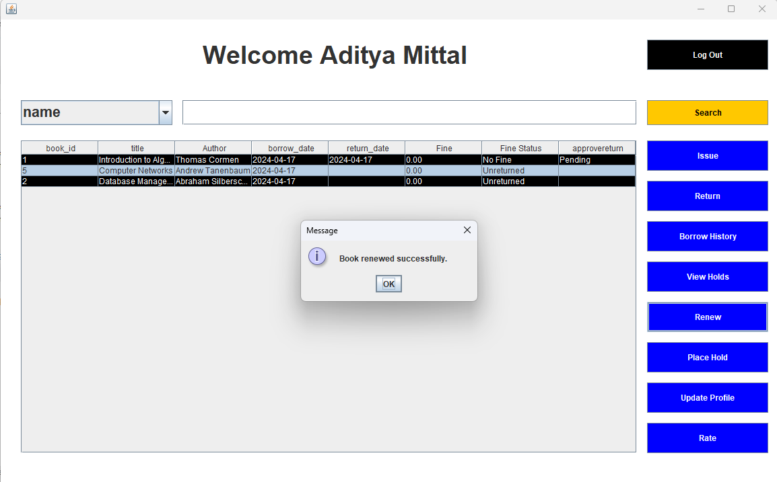
Renew feature
User can select the book to be renew from his borrow history.

Slide 15
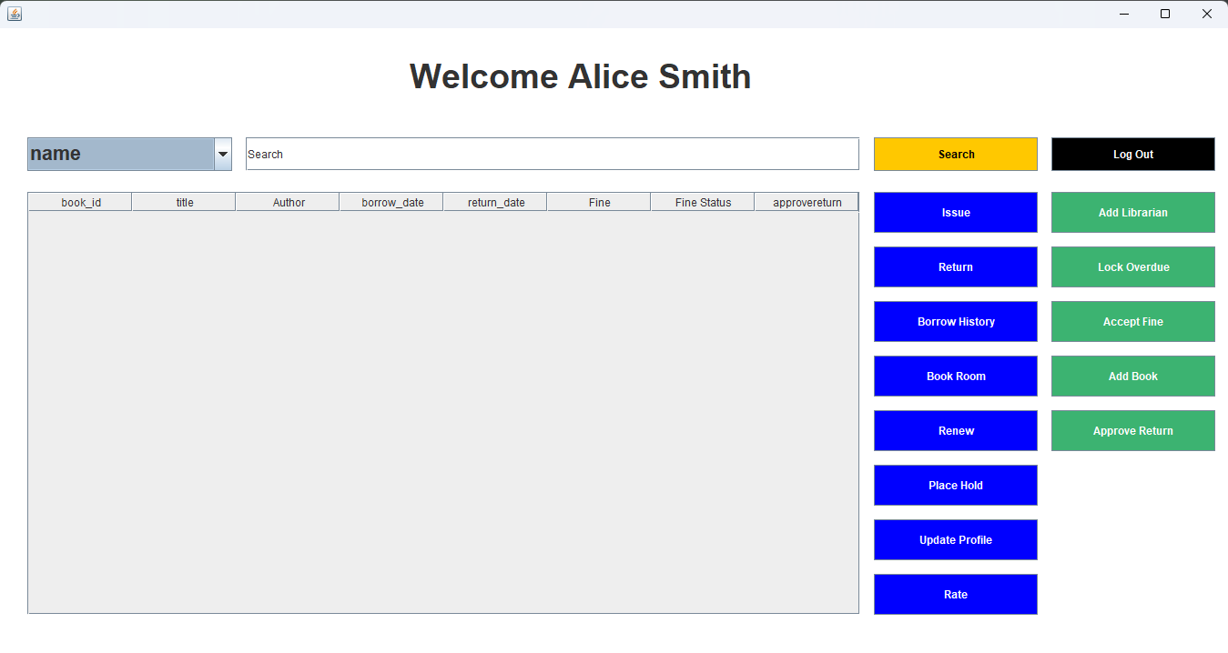
Librarian Dashboard
Has all features as the member along with four additional features:
  Add Librarian
  Add Books
  Accept returns
  Accept dues
  Lock Overdue

Slide 16
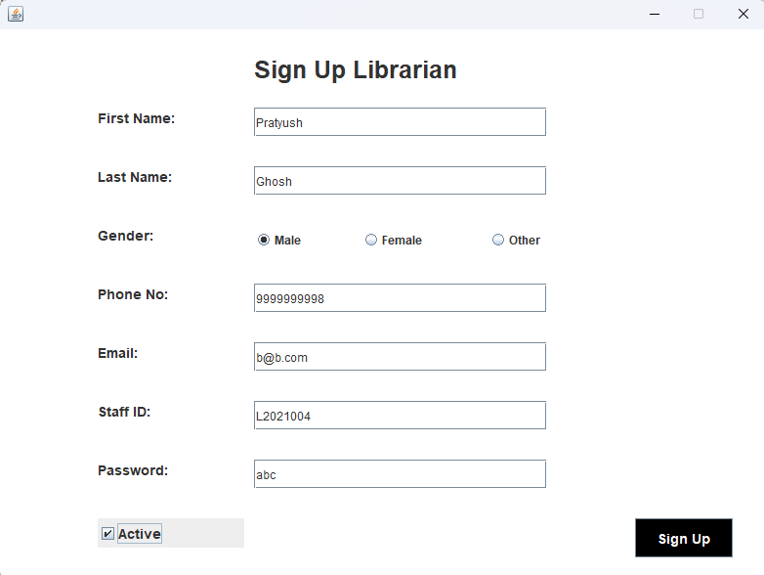
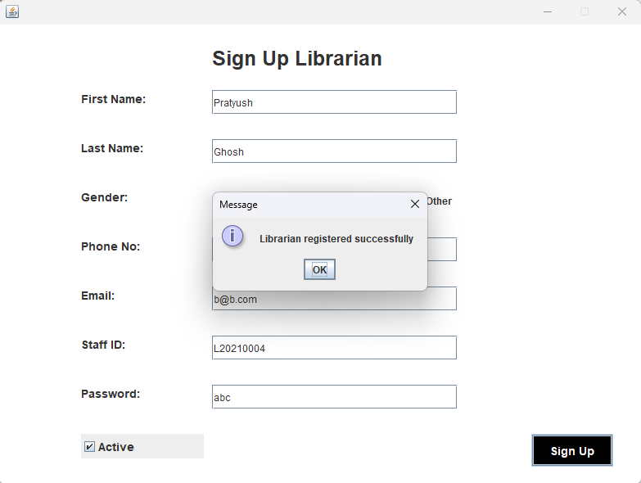
Add Librarian:
Allows librarian to add a new librarian.
This opens the window where personal details of the librarian need to be filled.

Slide 17
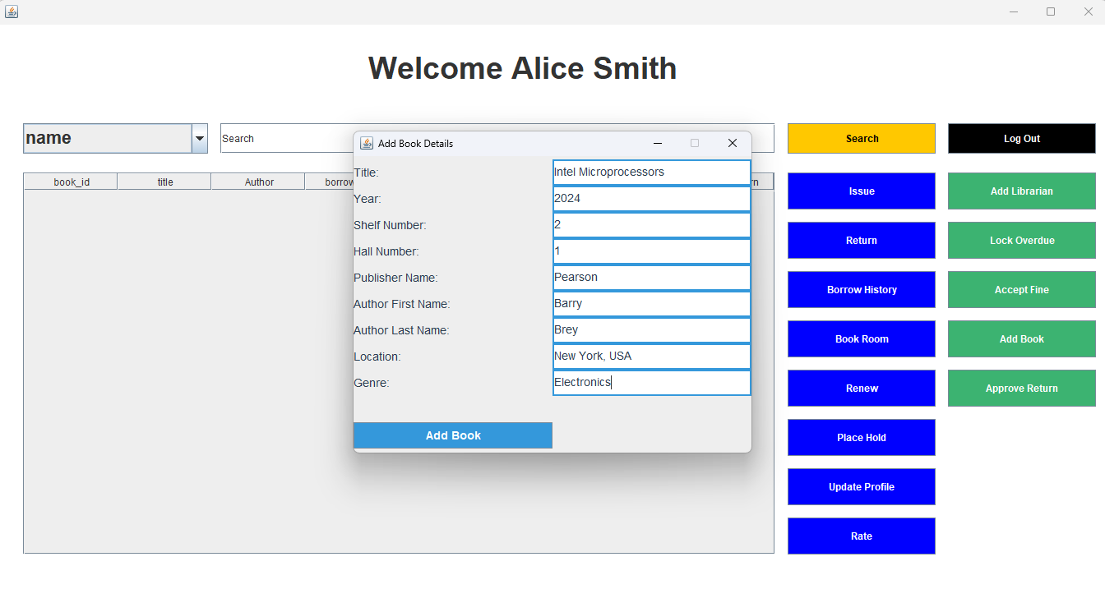
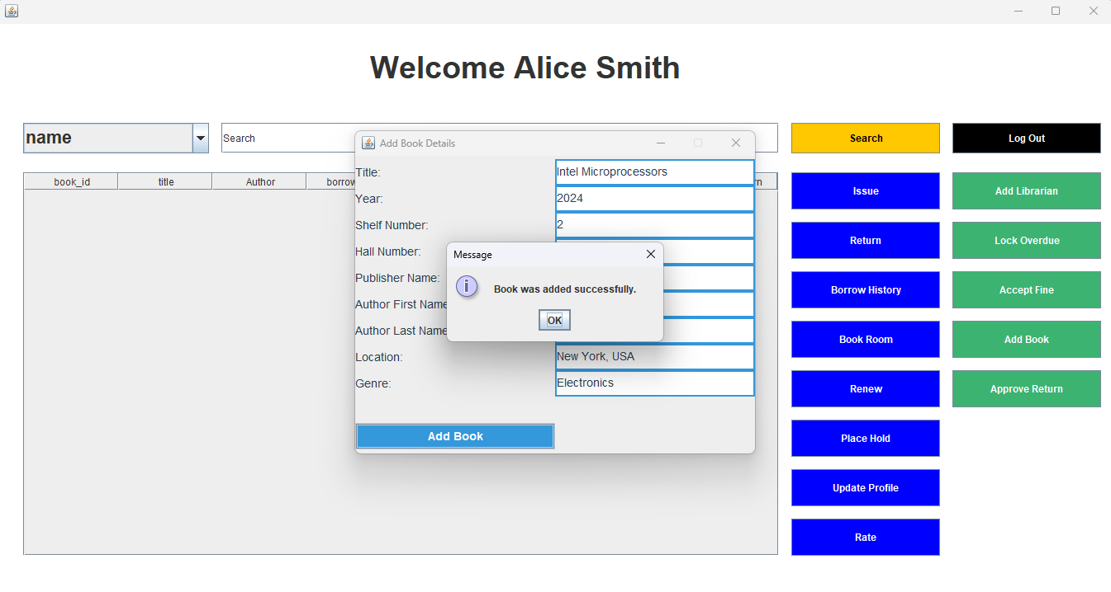
Add Books:
This feature allows the librarian to add new books to the inventory.
It open the window where details of the book is to be filled.

Slide 18

Accept Returns:
Approves all the return request made by the member at once.

Slide 19
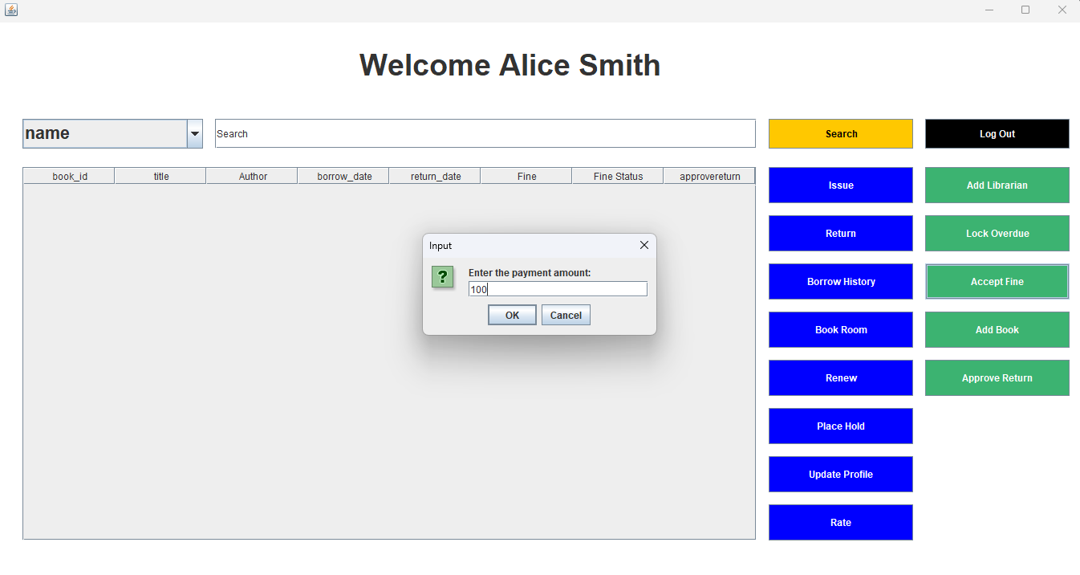
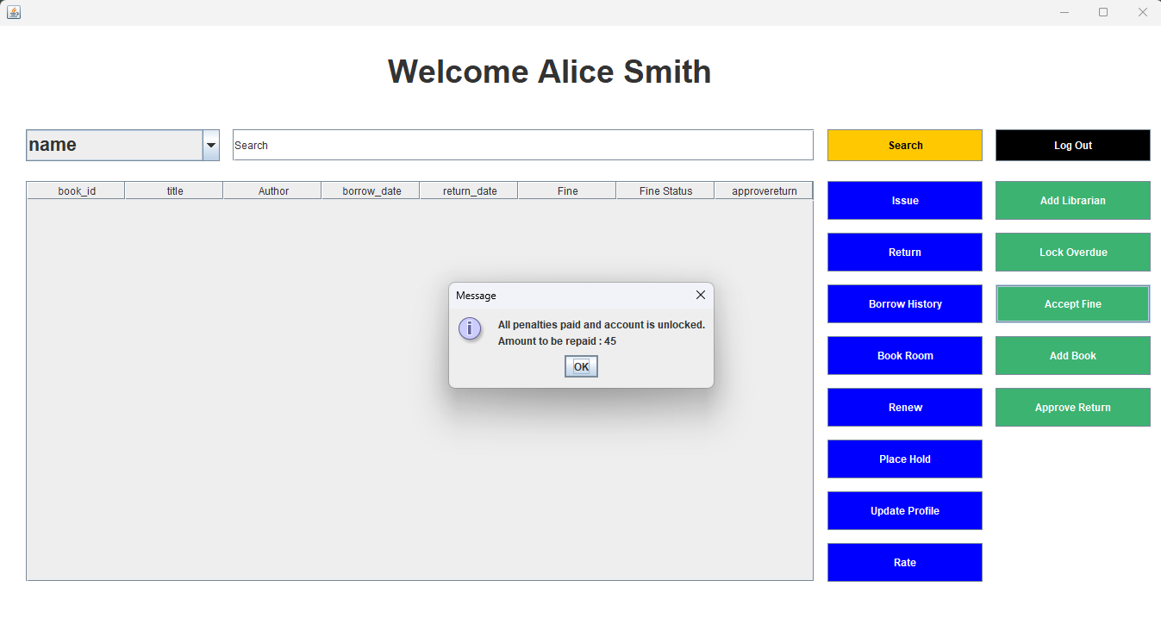
Accept dues
It requires Librarian to enter the amount submitted by the member.
Remaining amount to be returned is displayed.
If given amount is not enough to clear the due, full amount is returned and no change is made in the database.

Slide 20
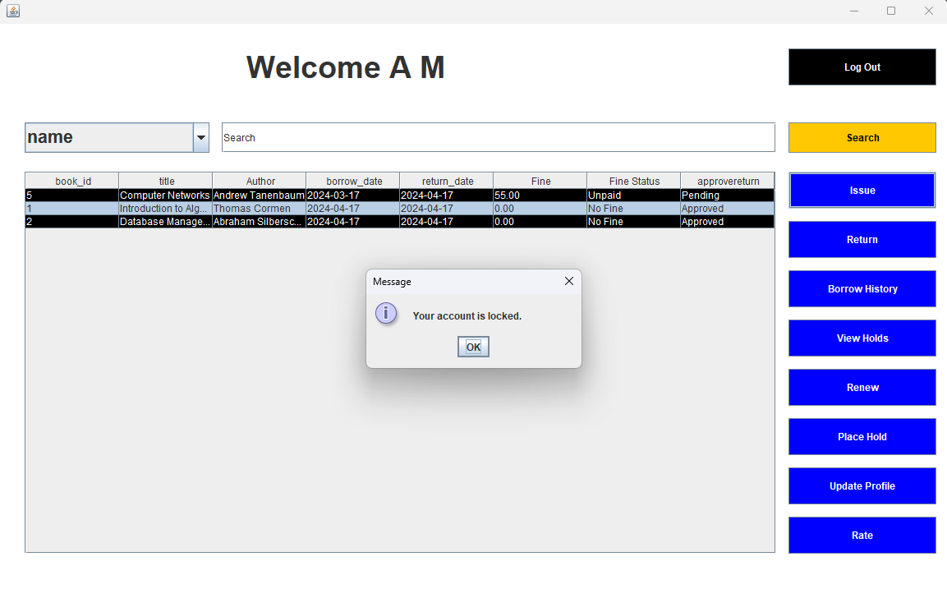
Lock Overdue
Librarian can temporarily block account running on overdue which can only be unlocked once the fine is cleared.

